Slide 1


Smart Contract Development With Solidity
Optimizing Contracts
SoftUni Team
Technical Trainers
Software University
http://softuni.bg

Slide 2
Table of Contents
Abstract
Costs of EVM operations
Contract publishing
Lowering deploy cost
Anti-patterns
Libraries & External calls
State reads/writes
Memory caching

Slide 3
Questions
sli.do #SContracts

Slide 4
Prepare for Failure
Any non-trivial contract will have errors in it. Your code must, therefore, be able to respond to bugs and vulnerabilities gracefully.
Pause the contract when things are going wrong ('circuit breaker')
Manage the amount of money at risk (rate limiting, maximum usage)

Slide 5
Rollout carefully
It is always better to catch bugs before a full production release
Test contracts thoroughly, and add tests whenever new attack vectors are discovered
Provide bug bounties starting from alpha testnet releases
Rollout in phases, with increasing usage and testing in each
phase

Slide 6
Keep Contracts Simple (KCS) (KISS?)
Ensure the contract logic is simple
Modularize code to keep contracts and functions small
Use already-written tools or code where possible (e.g. don‘t roll your own random number generator)
Prefer clarity to performance whenever possible
Only use the blockchain for the parts of your system that require decentralization

Slide 7
Stay up to Date
Keep track of new security developments.
Check your contracts for any new bug that's discovered
Upgrade to the latest version of any tool or library as soon as possible
Adopt new security techniques that appear useful

Slide 8
Fundamental Tradeoffs
Simplicity versus Complexity cases
Rigid versus Upgradeable
Monolithic versus Modular
Duplication versus Reuse
Notes:
There are multiple fundamental tradeoffs to consider when assessing the structure and security of a smart contract system. The general recommendation for any smart contract system is to identify the proper balance for these fundamental tradeoffs.
An ideal smart contract system from a software engineering bias is modular, reuses code instead of duplicating it, and supports upgradeable components. An ideal smart contract system from a secure architecture bias may share this mindset, especially in the case of more complex smart contract systems.
However, there are important exceptions where security and software engineering best practices may not be aligned. In each case, the proper balance is obtained by identifying the optimal mix of properties along contract system dimensions
Rigid versus Upgradeable
While multiple resources, emphasize malleability characteristics such as Killable, Upgradeable or Modifiable patterns there is a fundamental tradeoff between malleability and security.
Malleability patterns by definition add complexity and potential attack surfaces. Simplicity is particularly effective over complexity in cases where the smart contract system performs a very limited set of functionality for a pre-defined limited period of time, for example, a governance-free finite-time-frame token-sale contract system.
Monolithic versus Modular
A monolithic self-contained contract keeps all knowledge locally identifiable and readable. While there are few smart contract systems held in high regard that exist as monoliths, there is an argument to be made for extreme locality of data and flow - for example, in the case of optimizing code review efficiency.
As with the other tradeoffs considered here, security best practices trend away from software engineering best practices in simple short-lived contracts and trend toward software engineering best practices in the case of more complex perpetual contract systems.
Duplication versus Reuse
A smart contract system from a software engineering perspective wishes to maximize reuse where reasonable. There are many ways to reuse contract code in Solidity. Using proven previously-deployed contracts which you own is generally the safest manner to achieve code reuse.
Duplication is frequently relied upon in cases where self-owned previously-deployed contracts are not available. Efforts such as Zeppelin Solidity seek to provide patterns such that secure code can be re-used without duplication. Any contract security analyses must include any re-used code that has not previously established a level of trust commensurate with the funds at risk in the target smart contract system.

Slide 9
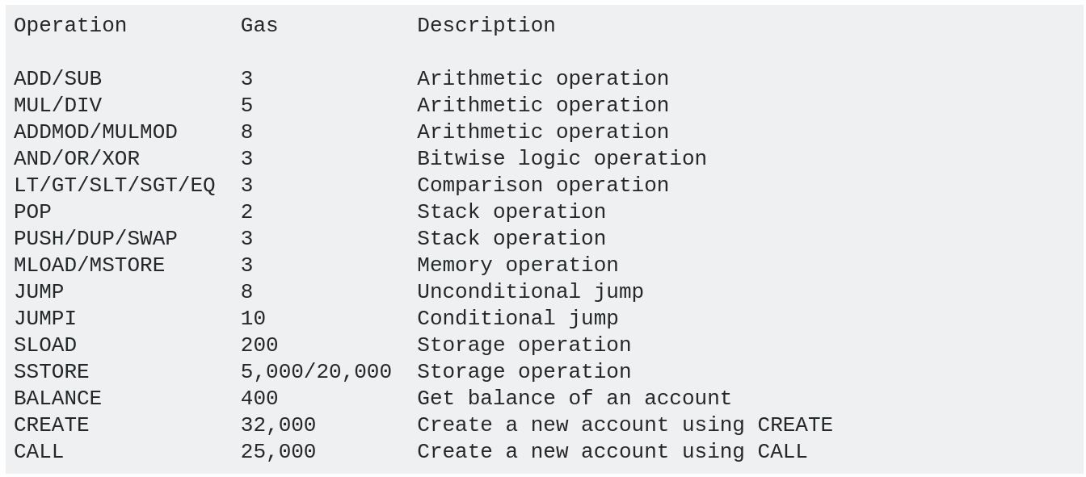
Gas Costs of Common OP Codes (EVM Operations)

Slide 10
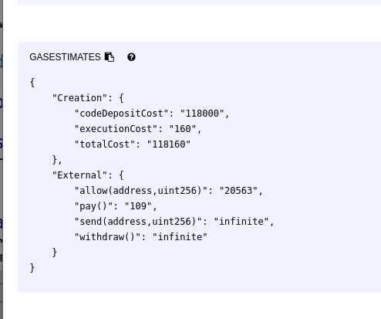
Using Remix to Measure Gas Costs (1/2)
Remix can estimate your gas expenses
Even on functions, if they are constant execution

Slide 11
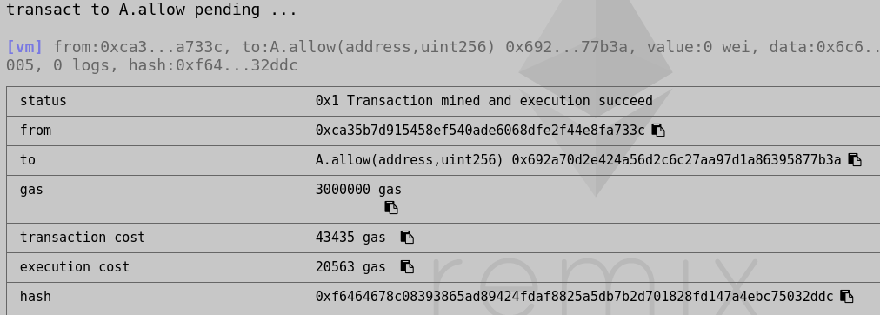
Using Remix to Measure Gas Costs (2/2)
When in doubt which way is more efficient, try both ways and measure the gas costs in Remix

Slide 12

Contract Deploy Gas Cost
The cost of uploading the bytecode + the cost of executing the constructor
Large contracts can easily go over the gas limit on publishing

Slide 13
Lowering Deploy Costs
Write clean, consistent good code :)
If you repeat certain operations often, make them a function
Move logic to Libraries if appropriate
They are published separately
Use modifiers for common checks
Do as little as possible in the constructor

Slide 14
Deploy Costs
contract B {
uint[] data;
address owner;
bool initialized;
constructor() public {
owner = msg.sender;
}
function init(uint[] _data) public {
require(owner == msg.sender);
require(!initialized);
data = _data;
initialized = true;
}
}
contract A {
uint[] data;
address owner;
constructor(uint[] _data) public {
owner = msg.sender;
data = _data;
}
}

Slide 15

Lowering Deploy Costs - init() function
Have a minimal constructor
Write a separate init function for the rest of the initialization
Make sure to call it afterwards!

Slide 16
General Tips
Avoid loops of unknown iterations whenever possible
Always aim for constant execution
If you cannot avoid loops, try to use less costly operations or find alternative ways to structure the contract
Write flexible, reusable code
Don’t have separate code for 2 similar actions

Slide 17
Pack your variables
uint8 numberOne;
uint256 bigNumber;
uint8 numberTwo;
uint8 numberOne;
uint8 numberTwo;
uint257 bigNumber;

Slide 18
uint8 is not always cheaper than uint256
The EVM only operates on 32 bytes/ 256 bits at a time. This means that if you use uint8, EVM has to first convert it uint256 to work on it and the conversion costs extra gas!

Slide 19
Function modifiers can be inefficient
https://github.com/PolymathNetwork/polymath-core/pull/548/commits/2dc0286f4e96241eed9603534607431a8a84ba35#diff-8b6746c2c4e7c9e3fca67d62718d70e8
Notes:
When you add a function modifier, the code of that function is picked up and put in the function modifier in place of the _ symbol. This can also be understood as ‘The function modifiers are inlined”. In normal programming languages, inlining small code is more efficient without any real drawback but Solidity is no ordinary language. In Solidity, the maximum size of a contract is restricted to 24 KB

Slide 20
Booleans use 8 bits while you only need 1 bit
Under the hood of Solidity, Booleans (bool) are uint8
You can pack 256 booleans in a single word
function getBoolean(uint256 _packedBools, uint256 _boolNumber)
public view returns(bool)
{
uint256 flag = (_packedBools >> _boolNumber) & uint256(1);
return (flag == 1 ? true : false);
}

Slide 21
Booleans use 8 bits while you only need 1 bit
Under the hood of Solidity, Booleans (bool) are uint8
You can pack 256 booleans in a single word
function setBoolean(
uint256 _packedBools,
uint256 _boolNumber,
bool _value
) public view returns(uint256) {
if (_value)
return _packedBools | uint256(1) << _boolNumber;
else
return _packedBools & ~(uint256(1) << _boolNumber);
}

Slide 22
Mappings are cheaper than Arrays!
This is because of how EVM works, An array is not stored sequentially in memory but as a mapping. You can pack Arrays but not Mappings though. So, it’s cheaper to use arrays if you are using smaller elements like uint8 which can be packed together.

Slide 23
Use bytes32 rather than string/bytes.
If you can fit your data in 32 bytes, then you should use bytes32 datatype rather than bytes or strings as it is much cheaper in Solidity.
Any fixed size variable in solidity is cheaper than variable size.
Always prefer fixed size over dynamic arrays
Use bytesX (x >= 1 && x <= 32) for short string data
Or when you don’t need to modify the different bytes

Slide 24
Make fewer external calls.
Executions of external contracts are costly
Avoid calling contract functions externally
this.function() is an external call, function() is an internal
Do as few as possible value transfers at a time
Contract creation is also expensive and shouldn’t be used excessively

Slide 25
Delete variables that you don’t need.
In Ethereum, you get a gas refund for freeing up storage space. If you don’t need a variable anymore, you should delete it using the delete keyword provided by solidity or by setting it to its default value. This will also help in keeping the blockchain size smaller.

Slide 26
Use Short Circuiting rules to your advantage.
When using logical disjunction (||), logical conjunction (&&), make sure to order your functions correctly for optimal gas usage
In logical disjunction (OR), if the first function resolves to true, the second one won’t be executed and hence save you gas.
In logical disjunction (AND), if the first function evaluates to false, the next function won’t be evaluated.

Slide 27
Storage Operations
Writing to contract state is extremely expensive
20000 gas for 32 bytes writing!
Reading from it is also expensive
Do as little reads/writes as you can

Slide 28
Avoid changing storage data.
contract MemoryCopy {
uint[] public data;
constructor() {
data.push(3);
data.push(4);
}
function doStuff() {
//copies data from storage to memory!
uint[] memory _data = data;
//doesn't change our data in storage
_data[0] += 10;
}
function doReferenceStuff() {
//_data is a reference to data
uint[] storage _data = data;
_data[0] += 10; //changes data in storage
}
}
Avoid it, unless necessary.

Slide 29
Libraries
Use them in large contracts
Provide clean and smaller code
Calling library functions has overhead!
It may be cheaper to implement the library functionality in your contract
library Adder {
function add(uint n, uint m) returns(uint){
return n+m;
}
}
contract B {
uint a;
uint b;
//42484 execution cost
function doStuff() returns(uint) {
a = 3;
b = 2;
return Adder.add(a, b);
}
//10650 execution cost
function doEfficientStuff() returns(uint) {
a = 3;
b = 2;
return a + b;
}
}

Slide 30

Avoid Too Much Global State Read
Operations like
balance lookup
Reading msg.*, block.*, tx.*

Slide 31
Memory Caching
Instead of doing operations on state variable, do them on local ones and write to state once
contract MemoryCache {
uint a = 3;
//53120 gas
function doStuff() {
for(uint i = 0; i<10; i++) {
a++;
}
}
//this method uses memory caching
//do most changes on local variables and
//write to storage at the end
//6145 gas
function doOptimalStuff() {
uint _a = a;
for(uint i = 0; i<10; i++) {
_a++;
}
a = _a;
}
}

Slide 32
Struct Initializing
contract A {
struct FourInts {
uint a;
uint b;
uint c;
uint d;
}
function doStuff() {
//WARNING! Don't remove the "memory":
//FourInts ints; - this is an unitialized storage pointer
//if you want to declare a local struct variable
//make it in memory
FourInts memory ints;
ints.a = 1;
ints.b = 2;
ints.c = 3;
ints.d = 4;
}
function doOptimalStuff() {
FourInts memory ints = FourInts({a: 1, b: 2, c: 3, d: 4});
}
}

Slide 33
Favor Pull Over Push for external calls (1/2)
contract Auction {
address highestBidder;
uint highestBid;
function bid() payable {
require(msg.value >= highestBid);
if (highestBidder != 0) {
// if this call consistently fails, no one else can bid
highestBidder.transfer(highestBid);
}
highestBidder = msg.sender;
highestBid = msg.value;
}
}

Slide 34
Favor Pull Over Push for external calls (2/2)
contract betterAuction {
address highestBidder;
uint highestBid;
mapping(address => uint) refunds;
function bid() payable external {
require(msg.value >= highestBid);
if (highestBidder != 0) {
// record the refund that this user can claim
refunds[highestBidder] += highestBid;
}
highestBidder = msg.sender;
highestBid = msg.value;
}
function withdrawRefund() external {
uint refund = refunds[msg.sender];
refunds[msg.sender] = 0;
msg.sender.transfer(refund);
}
}

Slide 35

Exercises

Slide 36

Exercise 1
Optimize the publishing and execution of this contract as much as possible: https://pastebin.com/Xivaxbjn

Slide 37
Exercise 2
Optimize the execution of this Voting contract: https://pastebin.com/VjEdbXLH
The voting process can be abused. Fix this
Fix all compile warnings

Slide 38
Exercise 3
Write a contract, that has a list of members (list of addresses given by owner)
When funds arrive in the contract, they should be evenly distributed on the members
The amount not able to be distributed stays in the contract
Implement this using a pull (withdraw) design!

Slide 39
https://softuni.bg/trainings/courses

Slide 40











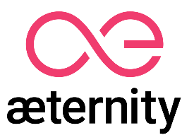

SoftUni Diamond Partners

Slide 41





SoftUni Organizational Partners

Slide 42




Trainings @ Software University (SoftUni)
Software University – High-Quality Education and Employment Opportunities
softuni.bg
Software University Foundation
http://softuni.foundation/
Software University @ Facebook
facebook.com/SoftwareUniversity
Software University Forums
forum.softuni.bg

Slide 43

License
This course (slides, examples, demos, videos, homework, etc.) is licensed under the "Creative Commons Attribution-NonCommercial-ShareAlike 4.0 International" license

